Slide 1
Gymnosperms
Class Teacher
Dr. Hannan Mukhtar
Assistant Professor
Department of Botany
Lahore College for Women University, Lahore Pakistan.
Course Description
Course Title: DIVERSITY OF PLANTS
Course code: Min/Bot-102
Credit hours: 4 (3+1)
Class
Course : BS I, 2nd Semester
Major: Zoology
Minor course: Botany

Slide 3
General characteristics of Gymnosperms
Gymnosperms were originated in Paleozoic era (541-252 million years ago).
They were the dominant plants of the Jurassic and Cretaceous periods of the Mezozoic era.
Most ancient seed bearing vascular plants containing 83 genera and 1080 species.
Many primitive gymnosperms are extinct.
Examples of living Gymnosperms Cycus, Pinus, Gnetum, Ephedra, Welwitshi, Texus, Cedrus, Abies and Araucaria
Morphological Characters
Gymnosperms (gymnos- naked and sperm- seed) are naked seeded plants.
Mostly are ever green woody, perennials with shrubby or tree habit
They show xerophytic chracteristics.
Mostly are very large in size.
Ovules are present on scales which are arranged to form a cone but ovules are exposed.

Slide 4
https://www.google.com/search?q=naked+seeds+of+gymnosperms

Slide 5
General characteristics of Gymnosperms
The plant body is sporophyte (diploid) differentiated into roots stems and leaves.
Gymnosperms are hetrosporous, produce two types of spores i.e. microspores and megaspore
Two types of sporangia are present microsporangia and megasporangia (pollen sac) which are produced on specialized leaves i.e. sporophylls.
Two types of sporophylls are present i.e. microsporophyll (stamen) contaning microsporangia and megasporophyll (carpel) containing mega sporangium (ovule).
The roots show symbiotic association with fungi and cyanobacteria.
Fungi form mychorrhizal association with the roots of Pinus. Mychorrhiza helps in absorption of minerals.
Algae ( Anabena and Nostoc) inhibits in the coralloid roots of Cycas , Which helps in nitrogen fixation.
The stem is usually erect branched and woody, unbranched in cycus underground in Zamia

Slide 6
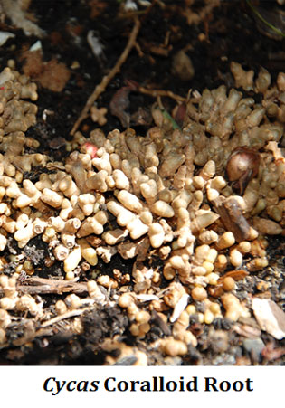
https://www.google.com/search?q=coralloid+roots+of+cycas

Slide 7
General characteristics of Gymnosperms
Presence of leaf scar is the characteristic feature of gymnosperms.
Leaves are usually dimorphic ( two types of leaves in same plants)
That are foliage and scale leaves.
Foliage leaves are green simple, simple or needle shaped or pinnately compound leaves.
Scale leaves are minute and decidous.
Cycus show circinate vernation
Presence of cercinate vernation in Cycus is the strong evidence of Pteridophytic origin of gymnosperms .
Cycus is a link between Pteridophytes and Gymnosperms.
Anatomical characters
The leaves of gymnosperms have very thick cuticle.
Mesophyll is differentiated into spongy and palisade tissue.

Slide 8
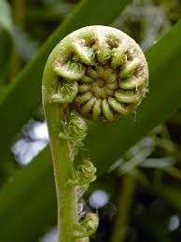
https://www.google.com/search?q=cercinate+vernation+in+zimia&tbm
https://www.google.com/search?q=foliage+and+scally++leaves+of+pinus&tbm

Slide 9
Sunken stomata are present
Have well developed vascular system consisting upon xylem and phloem
Vascular bundles are open and collateral.
Xylem
Consists of tracheid and parenchyma
Vessels are absent
Vessels are present in wood of Gnetum, is a strong evidence for the gymnospermic origin of Angiosperms. Gnetum is a connecting link between Angiosperms and gymnosperms.
Phloem
Consists of sieve tubes and phloem parenchyma.
Companion cells are absent.
Stem shows secondary growth
Wood may be manoxylic or pycnoxylic.

Slide 10
https://www.google.com/search?q=transfussion+tissue+in+gymnosperms

Slide 11
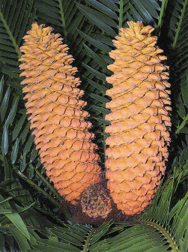
Tenniniferous cells present in cortex.
Roots are diarch (two) to polyarch (many) vascular bundles.
Reproduction in Gymnosperms
Hetrospory
Microsporangia are produced on Microsporophyll.
Megasporangia are produced on Megasporophyll.
Sporophylls aggregates to form cone or stobili.
Cones/ strobili are monosporangeate.
Male cone, Microspores and Microsporophyll
Male cones are short live.
Microsporangia are formed on the abaxial side of microsporophyll.
Microsporangium development is eusporangiate.
https://www.google.com/search?q=cycas+male+and+female+cone+diagram

Slide 12
Female cone, megasporophyll and mega sporangium
Female cone is formed by aggregation of megasporophylls.
Megasporophylls may be foliar as in Cycas or cauline (woody) as in Pinus.
Megasporangium is ovule
Ovular integument in gymnosperms is three layered.
Pollination and fertilization
Pollination by wind (Anemophily)
Pollen deposit in wet pollen chamber
Pollination siphonogamous (by pollen tube)
Male gametes non motile except in Ginko and Cycas
Number of archegonia in female gametophyte may vary.
There are several archegonia in Cycas only one in pinus.
Archegonium has ovum and neck canal cells (NCC)
Absent in Gnetum.

Slide 13
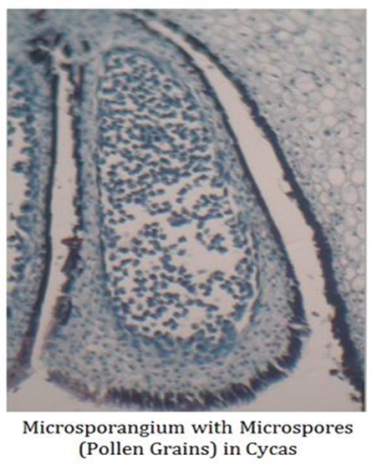
https://www.google.com/search?q=microsporangium+with+microspore+cycas

Slide 14
Embryo development is meroblastic (embryo develops from some part of zygote)
Endosperm is present in seeds of gymnosperms.
Endosperm is haploid (part of female gametophyte)
Double fertilization absent
Polyembryony is very common
Integument- seed coat
Seed are light weight and winged.
Alternation of generation is present
Diploid sporophytic generation is dominant phase.
Haploid gametophytic generation is highly reduced.
Gametophyte is dependant upon sporophyte.
https://www.easybiologyclass.com/general-characters-of-gymnosperms-lecture-notes-with-ppt/

Slide 15
Life cycle of Gymnosperms
https://www.google.com/search?q=general+characters+of+gymnosperms

Slide 16
PINUS
Kingdom Plantae
Subkingdom Tracheobionta
Superdivision Spermatophyta
Division Coniferophyta
Class Pinopsida
Order Pinales
Family Pinaceae
Genus Pinus L.

Slide 17
External Morphology of Pinus
Pinus is a large, perennial, evergreen plant.
Branches grow spirally and thus the plant gives the appearance of a conical or pyramidal structure.
Sporophytic plant body is differentiated into roots, stem and acicular (needle-like) leaves (Fig. 26).
A tap root with few root hair is present but it disap­pears soon. Later on many lateral roots develop, which help in absorption and fixation
The ultimate branches of these roots are covered by a covering of fungal hyphae called ectotrophic mycorrhiza.
The stem is cylindrical and erect, and remains cov­ered with bark. Branching is monopodial.
Two types of branches are present: long shoots and dwarf shoots. These are also known as branches of unlimited and limited growth, respec­tively

Slide 19
Long shoots contain apical bud and grow indefi­nitely. Many scaly leaves are present on the long shoot.
Dwarf shoots are devoid of any apical bud and thus are limited in their growth. They arise on the long shoot in the axil of scaly leaves.
A dwarf shoot (Fig. 27) has two scaly leaves called prophylls, followed by 5-13 cataphylls arranged in 2/5 phyllotaxy, and 1-5 needles.
The leaves are of two types, i.e., foliage and scaly.
Scaly leaves are thin, brown-coloured and scale like and develop only on long as well as dwarf shoots.
Foliage leaves are present at the apex of the dwarf shoots only.
Foliage leaves are large, needle-like, and vary in number from 1 to 5 in different species.
A spur (Fig. 28) is called unifoliar if only one leaf is present at the apex of the dwarf shoot, bifoliar if two leaves are present, trifoliar if three leaves are present, and so on.

Slide 21
Foliage leaves are large, needle-like, and vary in number from 1 to 5 in different species.
15. A spur is called unifoliar if only one leaf is present at the apex of the dwarf shoot, bifoliar if two leaves are present, trifoliar if three leaves are present, and so on.
Pinus Species Pinus monophylla
P. sylvestris
P. gerardiana
P. quadrifolia
P. wallichiana-pentafoliar

Slide 22
Anatomical study
T.S. Root Showing Secondary Growth:
On the outer side are present a few layers of cork, formed by the meristematic activity of the cork cam­bium.
Cork cambium cuts secondary cortex towards inner side.
Many resin canals and stone cells are present in the secondary cortex, the cells of which are sepa­rated with the intercellular spaces.
Below the phloem patches develop cambium, which cuts secondary phloem towards outer side and sec­ondary xylem towards inner side.
Crushed primary phloem is present outside the sec­ondary phloem (Fig. 30).
Many uniseriate medullary rays are present in the secondary xylem.
Primary xylem is the same as in young roots, i.e., each group is bifurcated (Y-shaped) and a resin canal is present in between the bifurcation.

Slide 24
T.S. Long Shoot :
Secondary growth, similar to that of a dicotyledon­ous stem, is present in the old stem of Pinus.
Cork cambium cuts cork towards outer side and a few layers of secondary cortex towards inner side.
Many tannin-filled cells and resin canals are dis­tributed in the primary cortex.
Cambium cuts secondary phloem towards outer side and secondary xylem towards inner side (Fig. 32).
Primary phloem is crushed and pushed towards outer side by the secondary phloem.
In the secondary xylem, annual rings of thin-walled spring wood (formed in spring season) and thick- walled autumn wood (formed in autumn season) are present alternately. Such a compact wood is called pycnoxylic (Age of the plant can be calcu­lated by counting the number of these annual rings).

Slide 25
Below the secondary xylem are present a few groups of endarch primary xylem.
Some of the medullary rays connect the pith with the cortex and called primary medullary rays while the others run in between secondary xylem and secondary phloem and called secondary medullary rays.
Central part of the stem is filled with the parenchy­matous pith.
Resin canals are present in cortex, secondary xylem, primary xylem and rarely in the pith

Slide 27
T.S. Needle (Foliage Leaf):
It is circular in outline in Pinus monophylla, semi­circular in P. sylvestris and triangular (Fig. 38) in P. longifolia, P. roxburghii, etc.
Outermost layer is epidermis, which consists of thick-walled cells. It is covered by a very strong cuticle.
Many sunken stomata are present on the epider­mis (Fig. 38).
Each stoma opens internally into a substomatal cavity and externally into a respiratory cavity or vestibule.
Below the epidermis are present a few layers of thick-walled sclerenchymatous hypodermis. It is well-developed at ridges.
In between the hypodermis and endodermis is present the mesophyll tissue.

Slide 28
Cells of the mesophyll are polygonal and filled with chloroplasts. Many peg-like infoldings of cellulose also arise from the inner side of the wall of meso­phyll cells.
Few resin canals are present in the mesophyll, adjoining the hypodermis. Their number is vari­able but generally they are two in number.
Endodermis is single-layered with barrel-shaped cells and clear casparian strips.
Pericycle is multilayered and consists of mainly par­enchymatous cells and some sclerenchymatous cells forming T-shaped girder, which separates two vascular bundles (Fig. 38). Transfusion tissue con­sists of tracheidial cells.
Two conjoint and collateral vascular bundles are present in the centre. These are closed but cam­bium may also present in the sections passing through the base of the needle.
Xylem lies towards the angular side and the phloem towards the convex side of the needle.

Slide 30
Reproductive Structures of Pinus:
Plant body is sporophytic.
Pinus is monoecious, and male and female flowers are present in the form of cones or strobili on the separate branches of the same plant.
Many male cones are present together in the form of clusters, each of which consists of many microsporophylls. The female cones consist of megasporophylls.
The male cones on the plant develop much earlier than the female cones.
Male Cone:
Separate a male cone from the cluster, study its struc­ture, cut its longitudinal section, study the structure of a single microsporophyll, and also prepare a slide of pollen grains and study.
The male cones develop in clusters (Fig. 39) in the axil of scaly leaves on long shoot.
They replace the dwarf shoots of the long shoot.
Each male cone is ovoid in shape and ranges from 1.5 to 2.5 cm. in length (Fig. 40).

Slide 31
A male cone (Fig. 41) consists of a large number of microsporophylls arranged spirally on the cone axis.
Each microsporophyll is small, membranous, brown-coloured structure.
A microsporophyll (Fig. 41) is comparable with the stamen of the flower of angiosperms because it consists of a stalk (=filament) with a terminal leafy expansion (= anther), the tip of which is projected upwards and called apophysis.
Two pouch-like microsporangia (= pollen sacs) are present on the abaxial or undersurface of each microsporophyll. In each microsporangium are present many microspores (= pollen grains).
Each microspore or pollen grain is a rounded and yellow-coloured, light, uninucleate structure with two outer coverings, i.e., thick outer exine and thin inner intine (Fig. 42).

Slide 32
The exine protrudes out on two sides in the form of two balloon-shaped wings. Wings help in floating and dispersal of pollen grains.
Wings help in floating and dispersal of pollen grains.
A few microsporophylls of lower side of cone are sterile. Sporangia are also not present on the adaxial surface of each microsporophyll of the male cone.

Slide 33
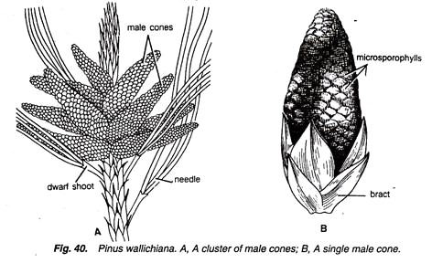

Slide 35
Female cone:
Observe the external features and longitudinal sec­tion of a young female cone and also study 1st year, 2nd year and 3rd year female cones.
Female cone develops either solitary or in groups of 2 to 4.
They also develop in the axil of scaly leaves on long shoots (Fig. 43) like male cones.
Each female cone is an ovoid, structure when young but becomes elongated or cylindrical at maturity.
L.S. Female Cone:
In the centre is present a cone axis (Fig. 44).
Many megasporophylls are arranged spirally on the cone axis.
A few megasporophylls, present at the base and at the apex of strobilus, are sterile.

Slide 36
Megasporophylls present in the middle of the stro­bilus are very large and they decrease in size to­wards the base and apex.
Each megasporophyll consists of two types of scales, known as bract scales and ovuliferous scales.
Bract scales are thin, dry, membranous, brown- coloured structures having fringed upper part. These are also called carpellary scales.
Each ovuliferous scale is woody, bigger and stouter than bract scale and it is triangular in shape. A broad sterile structure, with pointed tip, is present at the apex of these scales. This is called apophy­sis.
At the base of upper surface of each ovuliferous scale are present two sessile and naked ovules.

Slide 37
Micropyle of each ovule faces towards the cone axis.
Each ovule is orthotropous, and it remains sur­rounded by a single integument, consisting of an outer fleshy, a middle stony and an inner fleshy layer. It opens with a mouth opening called micro­pyle
Integument surrounds the megasporangium or nucellus.
Just opposite the micropyle is present a pollen chamber.
In the endosperm or female gametophyte are present 2 to 5 archegonia.

Slide 38
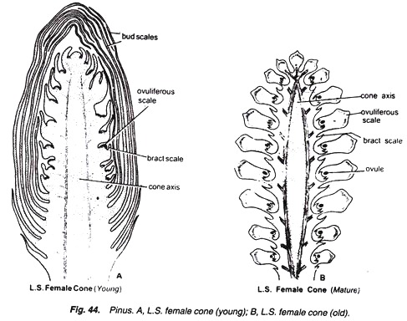

Slide 39
SEED

Slide 40
Both the ovules of each ovuliferous scale develop into seeds (Fig. 48)
Each seed contains a large membranous wing formed from the ovuliferous scale.
Anatomy of seed shows following (Fig. 48C) details:
It is enveloped by a seed coat developed from the middle stony layer of the ovule.
Inner fleshy layer may survive in the form a thin membrane. Outer fleshy layer disappears.
A thin, membranous and papery structure, called perisperm, develops inner to the seed coat.
Well-developed endosperm is present.
In the centre is present the embryo consisting of a hypocotyle, radicle, plumule and 2 to 14 or more cotyledons.
http://www.biologydiscussion.com/gymnosperm/pinus-external-morphology-and-different-parts/33923

Slide 41
CYCAS
https://www.youtube.com/watch?v=c_zLCU97K_8

